Slide 1
Snake Game
Thomas Mackin

Slide 2
Building Blocks
import
pygame
time
random
display.set_mode()
class player()
def
snake()
Game_score()
lose_message()
Snake_loop()
pygame.KEYDOWN

Slide 3
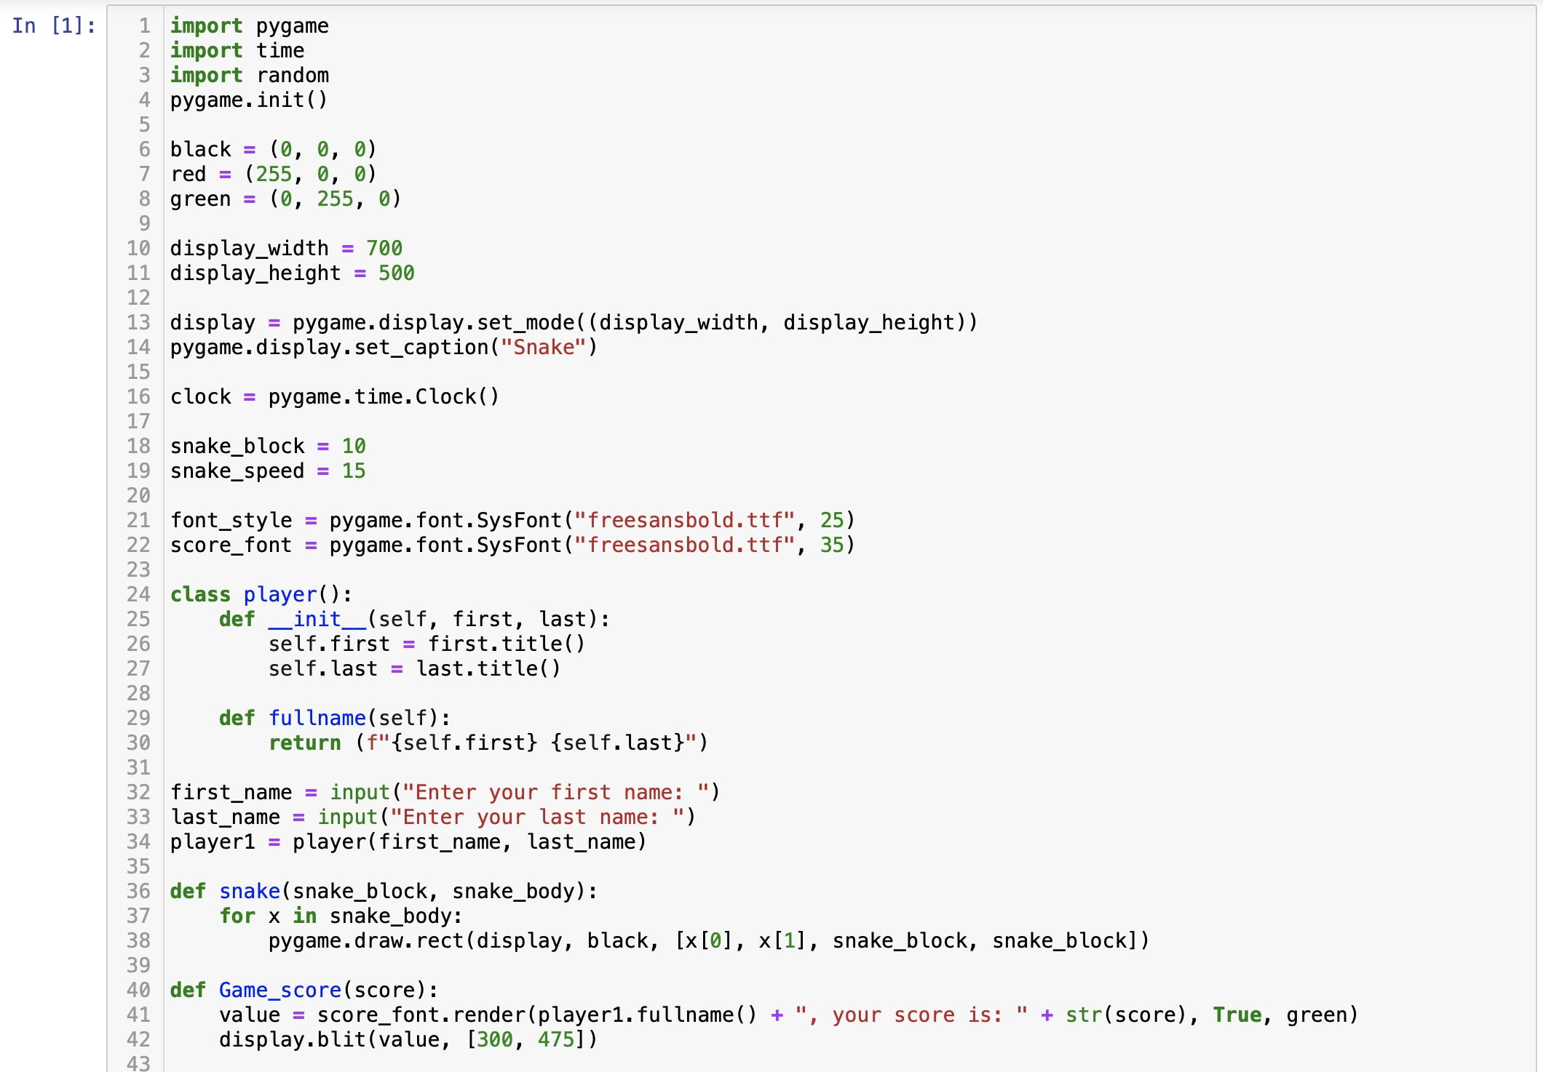
Code
Import
Colors
Display
Snake size and speed
Fonts

Slide 4
Code
Class player
Def snake
Def Game_score

Slide 5
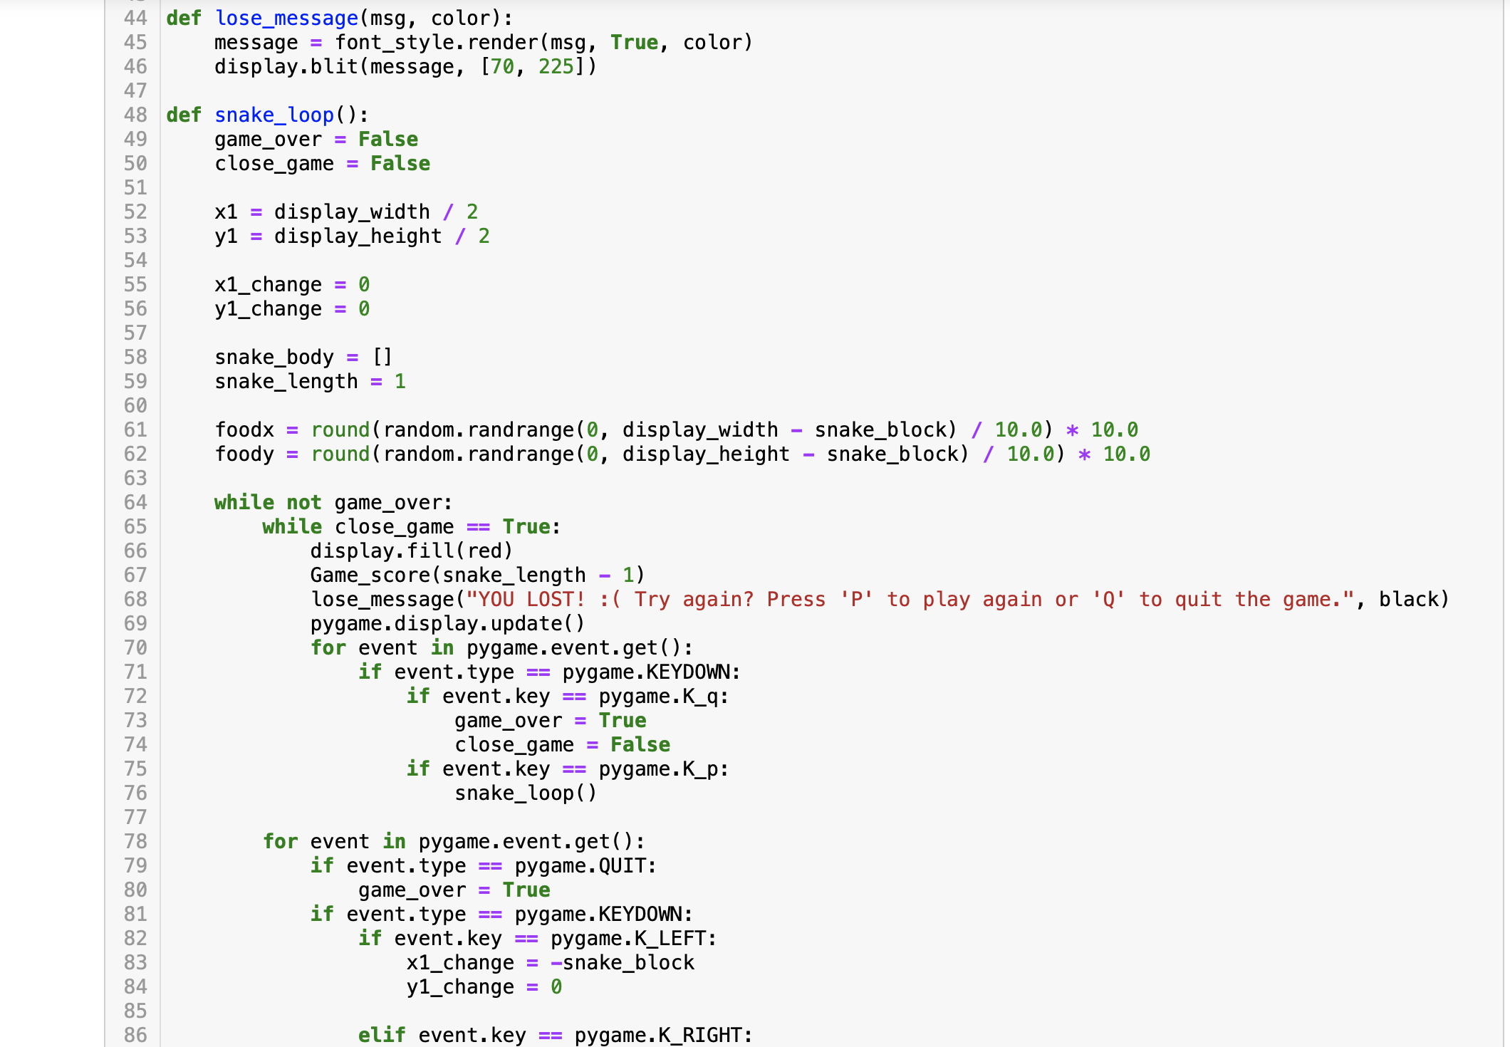
Code
Def lose_message
Def snake_loop
Lose_message
Q to quit
P to play again

Slide 6
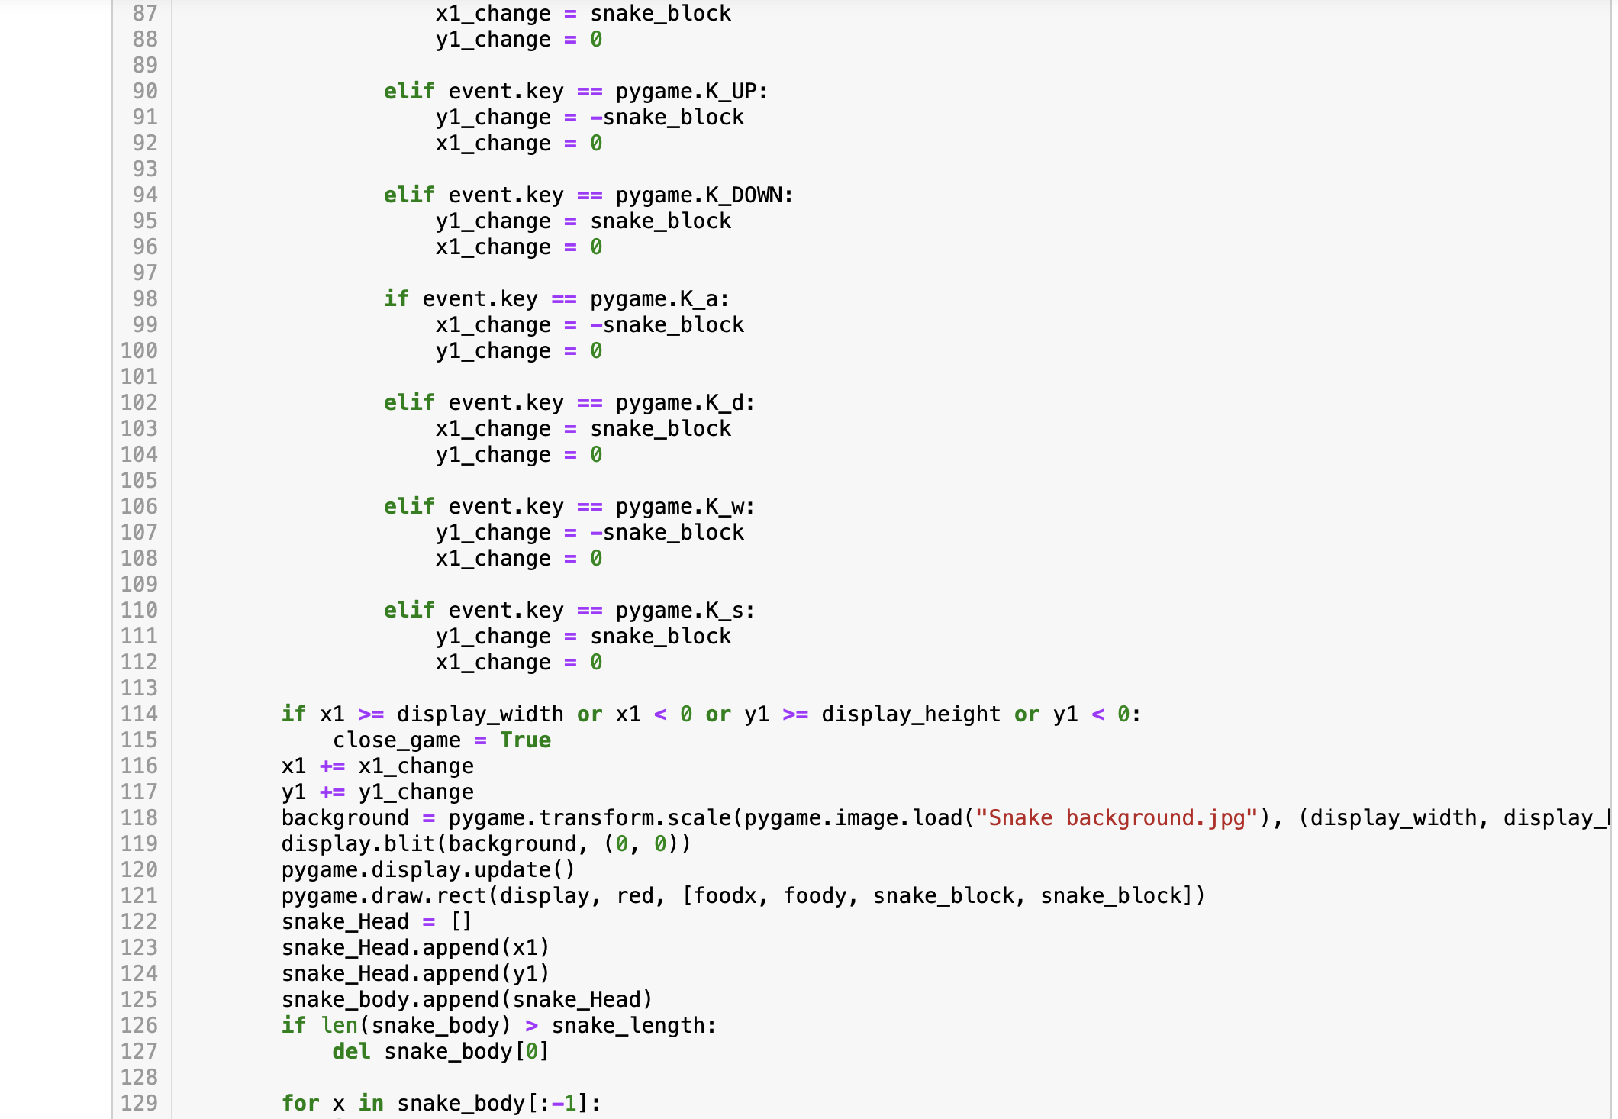
Code
Arrow keys or WASD

Slide 7
Code
Background image
Creating Food
Appending snake body

Slide 8
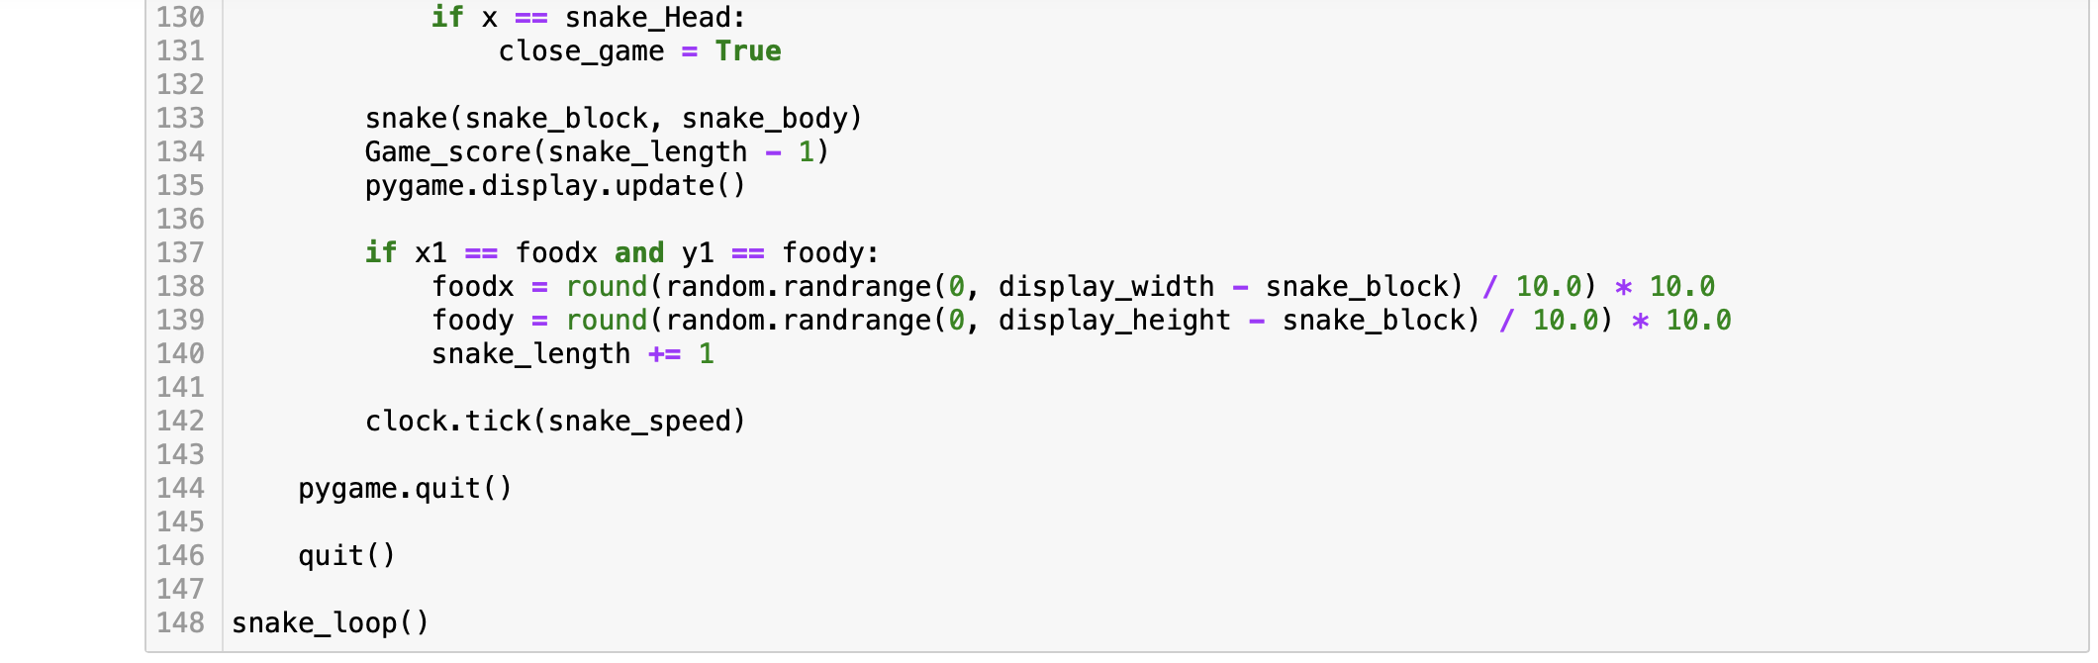
Code
Snake_length -1
Quit

